Slide 1

EDA of Seoul Bike Rentals: Insights for Business Optimization
Presented by- Aishwarya Patil
This presentation deeply investigate into on analysis of Seoul rental Bikes dataset. Uncovering key insights and provide actionable suggestions for rental bikes.

Slide 2
Purpose
Bike Rental Analysis
1
This project aim to analyze rental bikes data to identify key factors influencing rent pattern.
2
Operational efficiency
By understanding factors, bike rental management can make decisions to enhance operational efficiency.
Customer satisfaction
3
The analysis will help to identify customer preferences and enhance customer satisfaction.
4
Support Business Growth
The insights from the analysis will help management team to build strategies for business growth and revenue generation.

Slide 3
Summery
Dataset consists of 8,760 hourly records, number of bikes rented with various influencing factors such as time, weather conditions, and seasonal variations.
This dataset is useful for analyzing trends, understanding the impact of environmental factors on bike usage, and optimizing bike-sharing systems.
Before visualize, we will do the data cleaning as to fill any null values and delete any duplicated values, after that we will do data wrangling.
Also we will do data analysis for Seoul Bike. we also take help of charts for better analysis.

Slide 4

Problem statement
The goal is to analyze and predict bike rental demand in Seoul based on time-related factors (hour, season, holiday) and weather conditions (temperature, humidity, wind speed, etc.).
Understanding these patterns can help optimize bike availability, improve user experience, and support better decision-making for bike-sharing operations.

Slide 5
Agenda
Data overview
1
exploration of rental bikes data.
2
EDA and visualizations
with the help of charts get beneficial insights from dataset.
Recommendations for client
3
Based on derived insights, strategies are recommended to client.
4
conclusion
from all analysis the final conclusion is added.

Slide 6
Dataset Overview
Rented bike count
factor show impact on bike renting.
Holiday and Functioning Days
Visibility
Wind speed
rainfall
seasons
Temperature
humidity

Slide 7




Data cleaning process
Error Removal
Blank row and column removal
Duplicate Removal
Null value handling
aim to estimate data inconsistency.
empty rows are removed.
duplicate entries are removed for data accuracy.
replacing null values with 0

Slide 8
Data Wrangling
1
2
3
Rename the columns
Encode the categorical variables
saved cleaned data
columns are renamed for consistency and easy to read and work. Columns with special characters or spaces are renamed.
as there is no null values and duplicated values, rows count remain same.
Categorical variables are encoded as 0 and 1. Convert "Yes/No" into 1/0. Convert "Seasons" into numeric labels (e.g., Spring = 0, Summer = 1, etc.)
8760 rows
14 columns

Slide 9
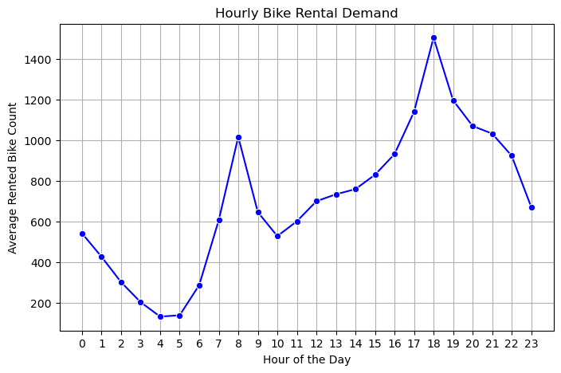
Data Visualization
Hourly Bike Rental Demand
Graph: Line Plot of Bike Rentals Over Time.
Insight: The highest demand for bike rentals occurs between 6 AM - 9 AM (morning commute) and 5 PM - 8 PM (evening commute).
Business Use: Helps in forecasting demand and adjusting bike availability.

Slide 10
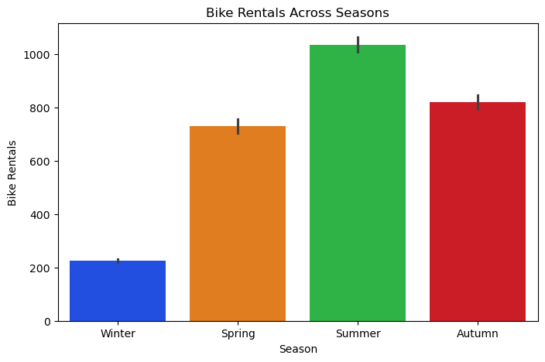
2. Rental bikes across the seasons
Graph: Bar Chart of Rentals per Season.
Insight: Highest demand in Spring & Autumn (pleasant weather). Lowest demand in Winter due to cold and snow.
Business Use: Plan promotions in low-demand seasons & maintenance schedules.

Slide 11
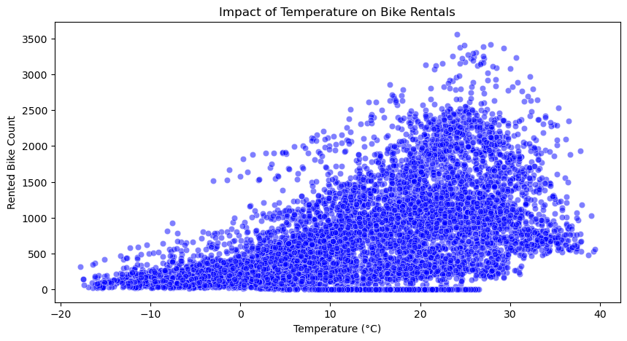
3. Impact of Temperature on Bike Rentals
Graph: Scatter Plot (Temperature vs. Rentals) +
Insight: Bike rentals increase with temperature, peaking around 15-25°C. Extreme temperatures (very hot or very cold) reduce bike usage.
Business Use: Plan dynamic pricing and special offers on extreme weather days.

Slide 12
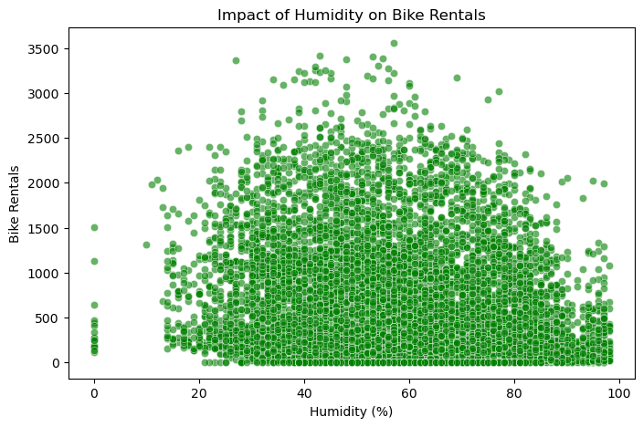
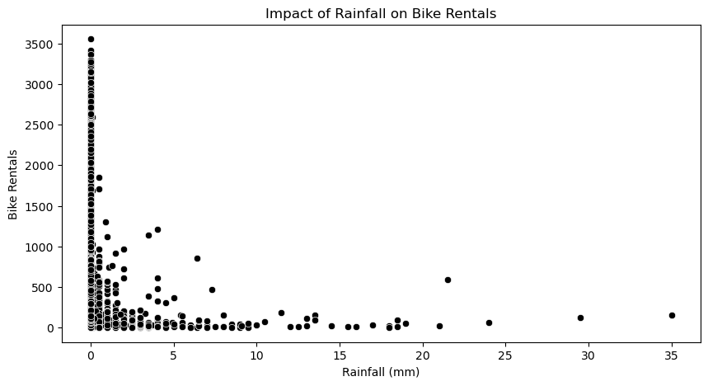
4.Rainfall vs. Bike Rentals
5.Humidity vs. Bike Rentals
Rainfall Impact: As rainfall increases, bike rentals drop sharply. Strategy: Introduce rainy-day discounts or partner with alternative transport services.
Humidity Impact: Higher humidity negatively affects rentals, as riding becomes uncomfortable. Strategy: Offer morning/evening promotions or cooling stations at high-traffic locations.

Slide 13
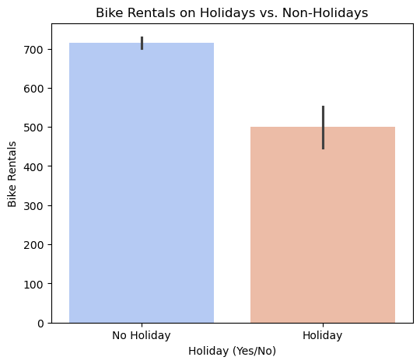
6. Bike rentals on Holidays Vs. Non-Holidays
Graph: Bar Chart (Bike Rentals on Holidays vs. Regular Days)
Insight: Shows whether people rent more on holidays. Fewer rentals on public holidays compared to working days. Bike usage drops on non-functioning days (weekends & holidays)
Business Use: Offer discounts on holidays or increase fleet availability.

Slide 14
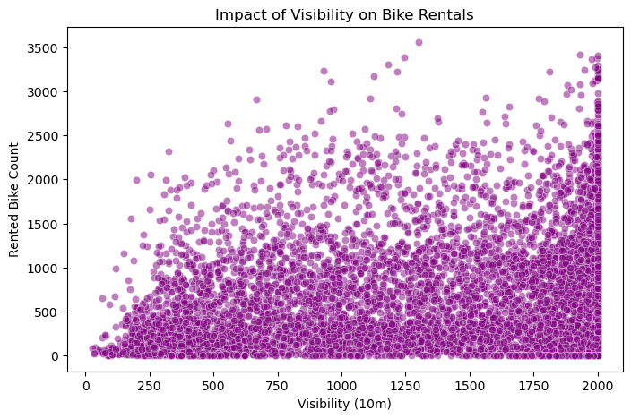
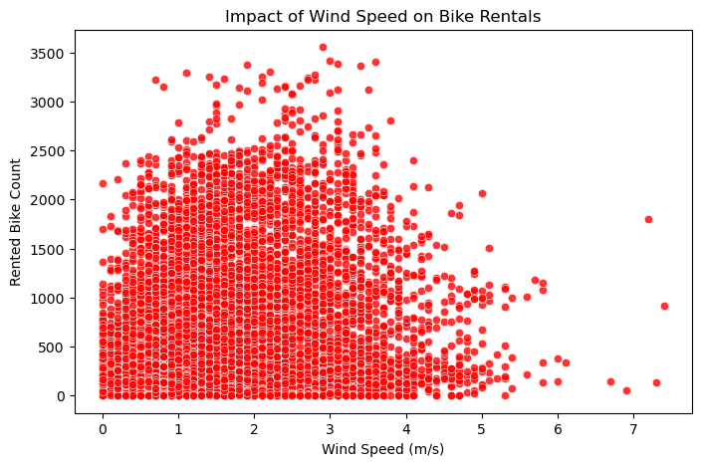
7. Impact of Visibility on Bike Rentals
8. Impact of Wind Speed on Bike Rentals
Graph: Scatter Plots (Visibility vs. Rentals, Wind Speed vs. Rentals)
Insight: Understand if low visibility or high wind speed reduces bike rentals. Poor visibility (fog) reduces rentals as safety concerns rise.
Strong winds also decrease bike usage.
Business Use: Helps in safety measures & predicting low-usage days.

Slide 15
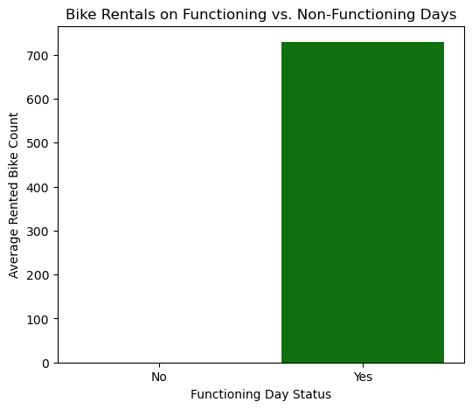
9. Bike Rentals on Functioning vs. Non-Functioning Days
Graph: Bar Chart of Rentals on Open vs. Closed Days
Insight: See how demand is affected on non-functioning days (e.g., maintenance or public holidays).Rentals are significantly higher on functioning days (working days) compared to non-functioning days (holidays or maintenance days). This confirms that bike rentals are primarily used for commuting .
Business Use: Plan maintenance schedules efficiently.

Slide 16
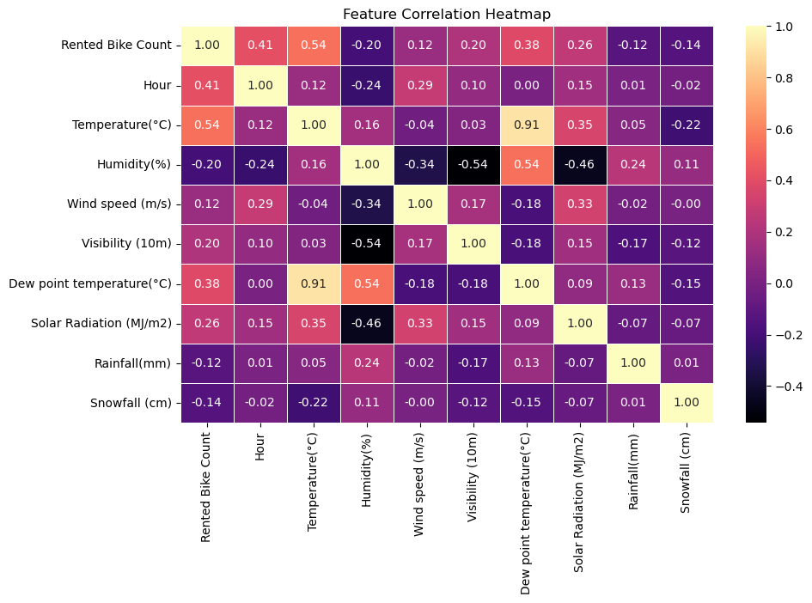
10. Heatmap
Graph: Heatmap of Feature Correlation
Insight: Identify which factors (e.g., temperature, humidity, hour, season) impact rentals the most.
Business Use: Helps in building accurate prediction models for demand forecasting.

Slide 17

Business Recommendation for client
Business Recommendations for the Client Based on the data analysis and visualizations:
1.Optimize Bike Availability
2. Seasonal Promotions & Discounts
3. Weather-Responsive Strategy
4. Weekend & Holiday Strategies
5. Subscription & Loyalty Programs
6. Infrastructure & Expansion Planning
By implementing these data-driven strategies,
the business can maximize bike usage, increase customer satisfaction,
and boost profitability.

Slide 18

Conclusion
The visual analysis of bike rentals reveals key business insights.
Hourly trends show peak demand during morning and evening commute hours, suggesting a need for more bike availability
during these times.
Seasonal analysis indicates lower rentals in winter, highlighting an opportunity for promotions or alternative services.
Weather conditions, especially rainfall and humidity, negatively impact bike rentals, suggesting the need for covered
parking or discounts on rainy days.
Holiday analysis reveals lower demand, allowing for maintenance scheduling on those days.
By optimizing bike availability, pricing strategies, and weather-based incentives, the business can enhance user satisfaction
and maximize revenue.
[

Slide 19


